Slide 1




MTN-025 (HOPE) Data Management Training: Prescreening
Statistical Center for HIV/AIDS Research & Prevention (SCHARP)
Fred Hutchinson Cancer Research Center

Slide 2
Recruitment/Prescreening
Documentation
Site Eligibility Recruitment Lists
Pre-Screening ID Assignment
Pre-Screening Outcome

Slide 3
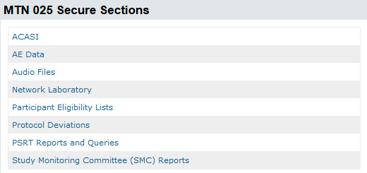

Site Eligibility Lists
Site Eligibility Recruitment Lists posted on Atlas to help sites track recruitment activities
https://atlas.scharp.org/cpas/project/MTN/025/Participant%20Eligibility%20Lists/begin.view?
Notes:
To help sites with study recruitment during the Pre-Screening process, SCHARP will provide each site with a PTID list of all enrolled participants in ASPIRE. This list will be available on a site-specific Atlas webpage. SCHARP will email each site when this list is available to download by the Site IoR or the HOPE study coordinator upon study activation.

Slide 4
Site Eligibility Lists
Listing will include PTIDs of all enrolled ASPIRE participants
  Preliminary Eligibility Status, including reasons for ineligibility
A code will be assigned for participants who seroconverted during ASPIRE to preserve confidentiality.
  Code list will also be posted to Atlas webpage
Notes:
Each site-specific recruitment will provide each ASPIRE participant’s preliminary eligibility status based on data from the ASPIRE study. Reasons for known ineligibility for HOPE will be indicated and include permanent discontinuation from study product during ASPIRE, if the participant seroconverted during the study or if the participant passed away.
A code will be assigned to each ASPIRE PTID who permanently discontinued from study product to preserve confidentiality for those participants who seroconverted during ASPIRE. This code list will be provided separately on the Atlas webpage.

Slide 5
Pre-Screening ID Assignment
Pre-Screening Number generated for all former ASPIRE participants
Pre-Screening Number will be generated in Medidata Rave
Transcribe the Pre-Screening Number in designated space next to her ASPIRE PTID on the Site Eligibility List
Notes:
Each former ASPIRE Participant will be assigned a number as part of the Pre-Screening Process. This number is called the Pre-Screening number and is generated in Medidata Rave when a participant is added to the database by site staff. The Pre-Screening Number should be transcribed on the Site Eligibility List to aid in tracking the outcome of the pre-screening process for each participant. (Pre-screening ID is labeled as Participant ID in Medidata Rave since this carries over for participant if participant screens/enrolls for study).

Slide 6
Pre-Screening Outcome CRF
Completed for each ASPIRE participant
Only CRF that is completed for ASPIRE participants who do not complete Screening Visit for HOPE
Purpose is to capture whether each ASPIRE participant contacted and scheduled for HOPE Screening Visit, or reasons why not contacted
Note: Coordinate completion of CRF with other study CRS’ if a former ASPIRE participant does not screen for HOPE at your site
Notes:
Once a pre-screening outcome is known for an ASPIRE participant, complete the Pre-Screening Outcome CRF. This CRF is required for each enrolled ASPIRE participant and thus, 2,629 Pre-Screening Outcome CRFs should be submitted across all HOPE sites. If a former ASPIRE participant does not complete a HOPE screening visit, the Pre-Screening Outcome CRF will be the only CRF that is completed for that ASPIRE participant.
Note that if a former ASPIRE participant who was enrolled at your site has relocated or chosen to screen at another HOPE study site, you will need to coordinate and ensure that the site at which the participant screens for HOPE adds the participant to the HOPE Medidata Rave database and completes the Pre-Screening Outcome form.

Slide 7
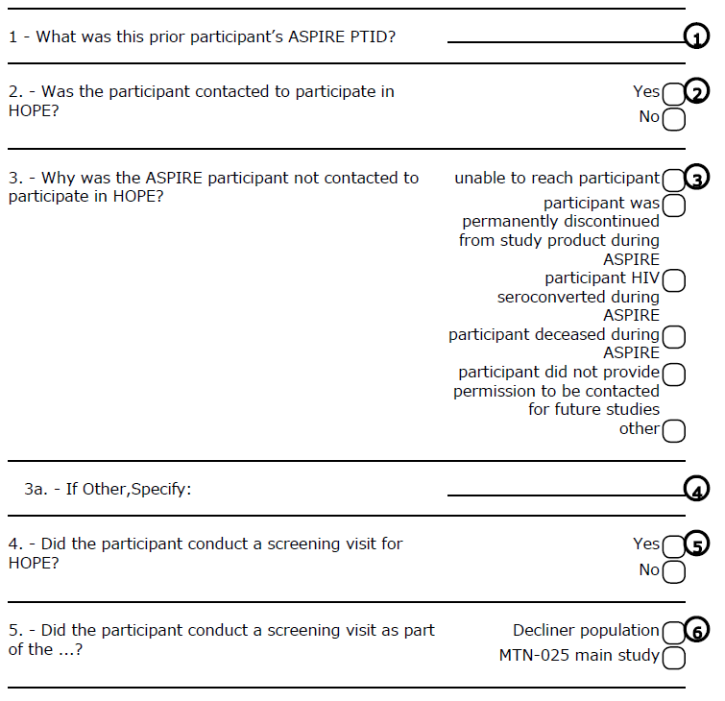
Pre-Screening Outcome CRF
Notes:
Participant ASPIRE PTID provided in this form to make a linkage for each participant across both studies.
This last question “Did the participant conduct a screening visit as part of the” is asked as a trigger question to populate the next forms based on if the participant is part of the Decliner population or MTN-025 main study population.

